Slide 1
Concurrency: Deadlock and Starvation
Operating Systems: Internals and Design Principles
Notes:
“Operating Systems: Internal and Design Principles”, 7/e, by William Stallings, Chapter 6 “Concurrency: Deadlock and Starvation”.

Slide 2
Operating Systems: Internals and Design Principles
When two trains approach each other at a crossing, both shall come to a full stop and neither shall start up again until the other has gone. Statute passed by the Kansas State Legislature, early in the 20th century.
—A TREASURY OF RAILROAD FOLKLORE,
B. A. Botkin and Alvin F. Harlow
Notes:
This chapter continues our survey of concurrency by looking at two problems that plague all efforts to support concurrent processing: deadlock and starvation. We begin with a discussion of the underlying principles of deadlock and the related problem of starvation. Then we examine the three common approaches to dealing with deadlock: prevention, detection, and avoidance. We then look at one of the classic problems used to illustrate both synchronization and deadlock issues: the dining philosophers problem.
As with Chapter 5 , the discussion in this chapter is limited to a consideration of concurrency and deadlock on a single system. Measures to deal with distributed deadlock problems are assessed in Chapter 18 .

Slide 3
Deadlock
The permanent blocking of a set of processes that either compete for system resources or communicate with each other
A set of processes is deadlocked when each process in the set is blocked awaiting an event that can only be triggered by another blocked process in the set
Permanent
No efficient solution
Notes:
Deadlock can be defined as the permanent blocking of a set of processes that either compete for system resources or communicate with each other. A set of processes is deadlocked when each process in the set is blocked awaiting an event (typically the freeing up of some requested resource) that can only be triggered by another blocked process in the set. Deadlock is permanent because none of the events is ever triggered. Unlike other problems in concurrent process management, there is no efficient solution in the general case.

Slide 4

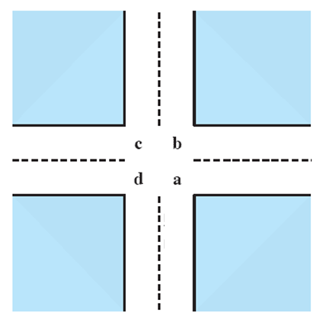
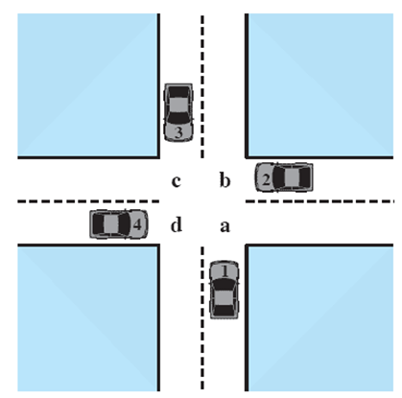



Potential Deadlock
I need quad C and D
I need quad B and C
I need quad A and B
I need quad D and A
Notes:
Animated Slide
Click 1 Cars approach intersection
Then Cars announce their resource needs
All deadlocks involve conflicting needs for resources by two or more processes. A common example is the traffic deadlock. Figure 6.1a shows a situation in which four cars have arrived at a four-way stop intersection at approximately the same time. The four quadrants of the intersection are the resources over which control is needed. In particular, if all four cars wish to go straight through the intersection, the resource requirements are as follows:
• Car 1, traveling north, needs quadrants a and b.
• Car 2 needs quadrants b and c.
• Car 3 needs quadrants c and d.
• Car 4 needs quadrants d and a.
The typical rule of the road in the United States is that a car at a four-way stop should defer to a car immediately to its right. This rule works if there are only two or three cars at the intersection. For example, if only the northbound and westbound cars arrive at the intersection, the northbound car will wait and the westbound car proceeds. However, if all four cars arrive at about the same time, each will refrain from entering the intersection, this causes a potential deadlock. The deadlock is only potential, not actual, because the necessary resources are available for any of the cars to proceed. If one car eventually does proceed, it can do so.

Slide 5
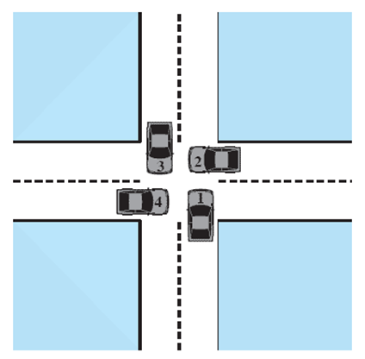
Actual Deadlock
HALT until D is free
HALT until C is free
HALT until B is free
HALT until A is free
Notes:
Animated Slide
Click 1 Cars move to deadlock
Then Cars announce their resource need
However, if all four cars ignore the rules and proceed (cautiously) into the intersection at the same time, then each car seizes one resource (one quadrant) but cannot proceed because the required second resource has already been seized by another car. This is an actual deadlock.

Slide 6
Resource Categories
Reusable
can be safely used by only one process at a time and is not depleted by that use
processors, I/O channels, main and secondary memory, devices, and data structures such as files, databases, and semaphores
Consumable
one that can be created (produced) and destroyed (consumed)
interrupts, signals, messages, and information
in I/O buffers
Notes:
Two general categories of resources can be distinguished: reusable and consumable. A reusable resource is one that can be safely used by only one process at a time and is not depleted by that use. Processes obtain resource units that they later release for reuse by other processes. Examples of reusable resources include processors; I/O channels; main and secondary memory; devices; and data structures such as files, databases, and semaphores.
A consumable resource is one that can be created (produced) and destroyed (consumed). Examples of consumable resources are interrupts, signals, messages, and information in I/O buffers.

Slide 7
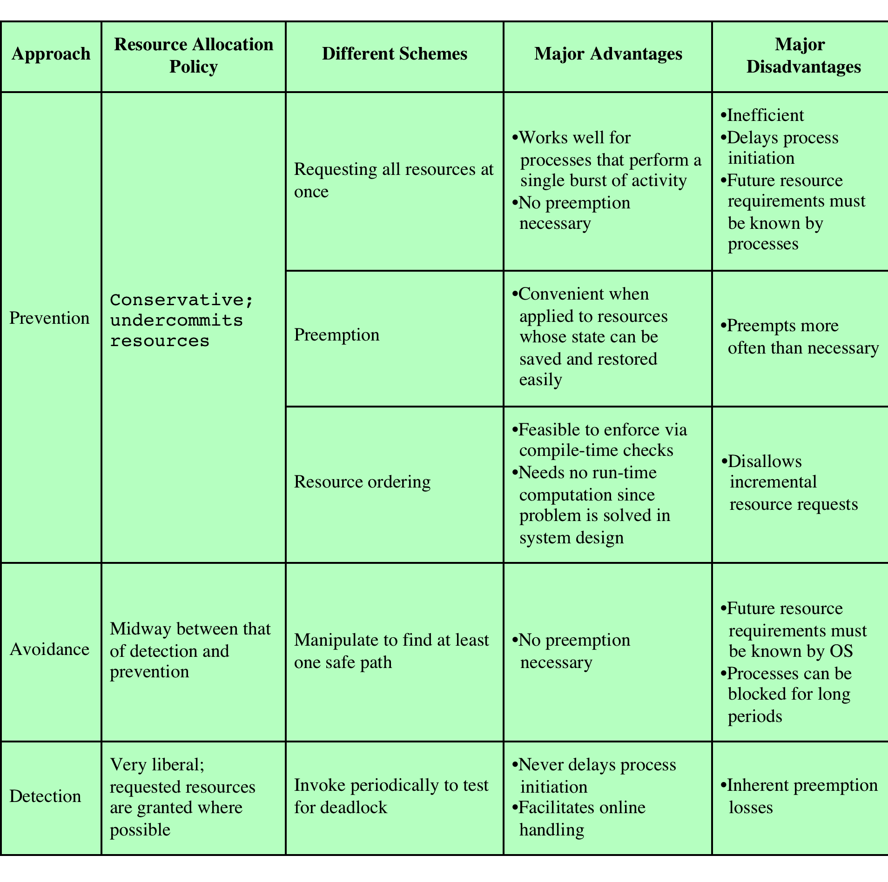
Deadlock Detection, Prevention, and Avoidance
Notes:
There is no single effective strategy that can deal with all types of deadlock. Table 6.1 summarizes the key elements of the most important approaches that have been developed: prevention, avoidance, and detection. We examine each of these in turn, after first introducing resource allocation graphs and then discussing the conditions for deadlock.

Slide 8
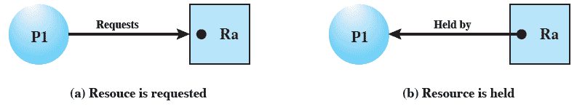
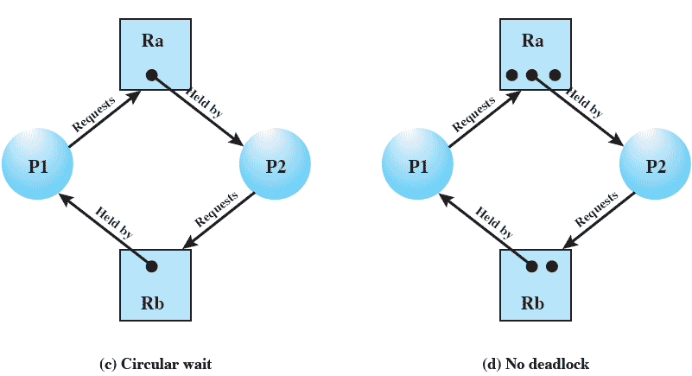
Resource Allocation Graphs
Notes:
A useful tool in characterizing the allocation of resources to processes is the resource allocation graph , introduced by Holt [HOLT72]. The resource allocation graph is a directed graph that depicts a state of the system of resources and processes, with each process and each resource represented by a node. A graph edge directed from a process to a resource indicates a resource that has been requested by the process but not yet granted ( Figure 6.5a ). Within a resource node, a dot is shown for each instance of that resource. Examples of resource types that may have multiple instances are I/O devices that are allocated by a resource management module in the OS. A graph edge directed from a reusable resource node dot to a process indicates a request that has been granted ( Figure 6.5b ); that is, the process has been assigned one unit of that resource. A graph edge directed from a consumable
resource node dot to a process indicates that the process is the producer of that
resource.
Figure 6.5c shows an example deadlock. There is only one unit each of resources Ra and Rb. Process P1 holds Rb and requests Ra, while P2 holds Ra but requests Rb. Figure 6.5d has the same topology as Figure 6.5c , but there is no deadlock because multiple units of each resource are available.

Slide 9
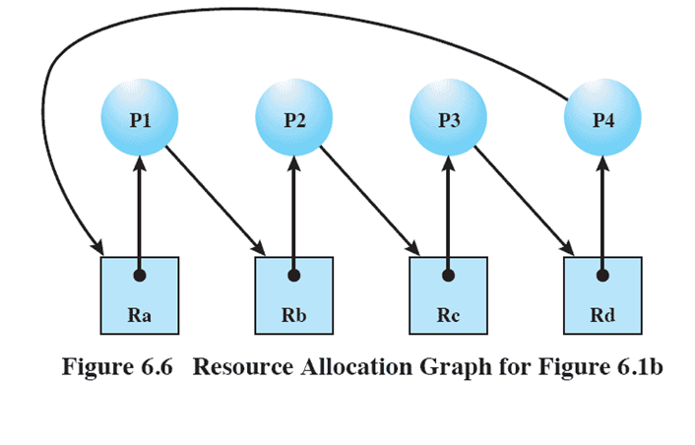
Resource Allocation Graphs
Notes:
The resource allocation graph of Figure 6.6 corresponds to the deadlock situation in Figure 6.1b . Note that in this case, we do not have a simple situation in which two processes each have one resource the other needs. Rather, in this case, there is a circular chain of processes and resources that results in deadlock.

Slide 10
Conditions for Deadlock
Mutual Exclusion
only one process may use a resource at a time
Hold-and-Wait
a process may hold allocated resources while awaiting assignment of others
No Pre-emption
no resource can be forcibly removed from a process holding it
Circular Wait
a closed chain of processes exists, such that each process holds at least one resource needed by the next process in the chain
Notes:
Three conditions of policy must be present for a deadlock to be possible:
1. Mutual exclusion . Only one process may use a resource at a time. No process may access a resource unit that has been allocated to another process.
2. Hold and wait . A process may hold allocated resources while awaiting assignment of other resources.
3. No preemption . No resource can be forcibly removed from a process holding it.
In many ways these conditions are quite desirable. For example, mutual exclusion is needed to ensure consistency of results and the integrity of a database. Similarly, preemption should not be done arbitrarily. For example, when data resources are involved, preemption must be supported by a rollback recovery mechanism, which restores a process and its resources to a suitable previous state from which the process can eventually repeat its actions.
The first three conditions are necessary but not sufficient for a deadlock to exist. For deadlock to actually take place, a fourth condition is required:
4. Circular wait . A closed chain of processes exists, such that each process holds at least one resource needed by the next process in the chain (e.g., Figure 6.5c
and Figure 6.6 ).
The fourth condition is, actually, a potential consequence of the first three. That is, given that the first three conditions exist, a sequence of events may occur that lead to an unresolvable circular wait. The unresolvable circular wait is in fact the definition of deadlock. The circular wait listed as condition 4 is unresolvable because the first three conditions hold. Thus, the four conditions, taken together, constitute necessary and sufficient conditions for deadlock.

Slide 11
Dealing with Deadlock
Three general approaches exist for dealing with deadlock:
Prevent Deadlock
adopt a policy that eliminates one of the conditions
Avoid Deadlock
make the appropriate dynamic choices based on the current state of resource allocation
Detect Deadlock
attempt to detect the presence of deadlock and take action to recover
Notes:
Three general approaches exist for dealing with deadlock. First, one can prevent deadlock by adopting a policy that eliminates one of the conditions (conditions 1 through 4). Second, one can avoid deadlock by making the appropriate dynamic choices based on the current state of resource allocation. Third, one can attempt to detect the presence of deadlock (conditions 1 through 4 hold) and take action to recover.

Slide 12
Deadlock Prevention Strategy
Design a system in such a way that the possibility of deadlock is excluded
Two main methods:
Indirect
prevent the occurrence of one of the three necessary conditions
Direct
prevent the occurrence of a circular wait
Notes:
The strategy of deadlock prevention is, simply put, to design a system in such a way that the possibility of deadlock is excluded. We can view deadlock prevention methods as falling into two classes. An indirect method of deadlock prevention is to prevent the occurrence of one of the three necessary conditions listed previously (items 1 through 3). A direct method of deadlock prevention is to prevent the occurrence of a circular wait (item 4).

Slide 13
Deadlock Condition Prevention
Mutual Exclusion
if access to a resource requires mutual exclusion then it must be supported by the OS
Hold and Wait
require that a process request all of its required resources at one time and blocking the process until all requests can be granted simultaneously
Notes:
Mutual Exclusion
In general, the first of the four listed conditions cannot be disallowed. If access to a resource requires mutual exclusion, then mutual exclusion must be supported by the OS. Some resources, such as files, may allow multiple accesses for reads but only exclusive access for writes. Even in this case, deadlock can occur if more than one process requires write permission.
Hold and Wait
The hold-and-wait condition can be prevented by requiring that a process request all of its required resources at one time and blocking the process until all requests can be granted simultaneously. This approach is inefficient in two ways. First, a process may be held up for a long time waiting for all of its resource requests to be filled, when in fact it could have proceeded with only some of the resources. Second, resources allocated to a process may remain unused for a considerable period, during which time they are denied to other processes. Another problem is that a process may not know in advance all of the resources that it will require.
There is also the practical problem created by the use of modular programming or a multithreaded structure for an application. An application would need to be aware of all resources that will be requested at all levels or in all modules to make the simultaneous request.

Slide 14
Deadlock Condition Prevention
No Preemption
if a process holding certain resources is denied a further request, that process must release its original resources and request them again
OS may preempt the second process and require it to release its resources
Circular Wait
define a linear ordering of resource types
Notes:
No Preemption
This condition can be prevented in several ways. First, if a process holding certain resources is denied a further request, that process must release its original resources and, if necessary, request them again together with the additional resource. Alternatively, if a process requests a resource that is currently held by another process, the OS may preempt the second process and require it to release its resources. This latter scheme would prevent deadlock only if no two processes possessed the same priority.
This approach is practical only when applied to resources whose state can be easily saved and restored later, as is the case with a processor.
Circular Wait
The circular-wait condition can be prevented by defining a linear ordering of resource types. If a process has been allocated resources of type R , then it may subsequently request only those resources of types following R in the ordering. To see that this strategy works, let us associate an index with each resource type. Then resource R i precedes R j in the ordering if i < j . Now suppose that two processes, A and B, are deadlocked because A has acquired R i and requested R j , and B has acquired R j and requested R i . This condition is impossible because it implies i < j and j < i .
As with hold-and-wait prevention, circular-wait prevention may be inefficient, slowing down processes and denying resource access unnecessarily.

Slide 15
Deadlock Avoidance
A decision is made dynamically whether the current resource allocation request will, if granted, potentially lead to a deadlock
Requires knowledge of future process requests
Notes:
An approach to solving the deadlock problem that differs subtly from deadlock prevention is deadlock avoidance. 2 In deadlock prevention , we constrain resource requests to prevent at least one of the four conditions of deadlock. This is either done indirectly, by preventing one of the three necessary policy conditions (mutual exclusion, hold and wait, no preemption), or directly, by preventing circular wait. This leads to inefficient use of resources and inefficient execution of processes. Deadlock avoidance , on the other hand, allows the three necessary conditions but makes judicious choices to assure that the deadlock point is never reached. As such, avoidance allows more concurrency than prevention. With deadlock avoidance, a decision is made dynamically whether the current resource allocation request will, if granted, potentially lead to a deadlock. Deadlock avoidance thus requires knowledge
of future process resource requests.

Slide 16
Two Approaches to Deadlock Avoidance
Deadlock Avoidance
Process Initiation Denial
Resource Allocation Denial
do not start a process if its demands might lead to deadlock
do not grant an incremental resource request to a process if this allocation might lead to deadlock
Notes:
In this section, we describe two approaches to deadlock avoidance:
• Do not start a process if its demands might lead to deadlock.
• Do not grant an incremental resource request to a process if this allocation might lead to deadlock.

Slide 17

Resource Allocation Denial
Referred to as the banker’s algorithm
State of the system reflects the current allocation of resources to processes
Safe state is one in which there is at least one sequence of resource allocations to processes that does not result in a deadlock
Unsafe state is a state that is not safe
Notes:
The strategy of resource allocation denial, referred to as the banker’s algorithm , was first proposed in [DIJK65]. Let us begin by defining the concepts of state and safe state. Consider a system with a fixed number of processes and a fixed number of resources. At any time a process may have zero or more resources allocated to it. The state of the system reflects the current allocation of resources to processes. Thus, the state consists of the two vectors, Resource and Available, and the two matrices, Claim and Allocation, defined earlier. A safe state is one in which there is at least one sequence of resource allocations to processes that does not result in a deadlock (i.e., all of the processes can be run to completion). An unsafe state is, of course, a state that is not safe.

Slide 18
Banker’s Algorithm
Concept: ensure that the system of processes and resources is always in a safe state
Mechanism: when a process makes a request for a set of resources
Assume that the request is granted
Update the system state accordingly
Determine if the result is a safe state
If so, grant he request; if not, block the process until it is safe to grant the request
Notes:
Deadlock avoidance has the advantage that it is not necessary to preempt and
rollback processes, as in deadlock detection, and is less restrictive than deadlock
prevention.

Slide 19
Deadlock Avoidance Advantages
It is not necessary to preempt and rollback processes, as in deadlock detection
It is less restrictive than deadlock prevention
Notes:
Deadlock avoidance has the advantage that it is not necessary to preempt and
rollback processes, as in deadlock detection, and is less restrictive than deadlock
prevention.

Slide 20
Deadlock Avoidance Restrictions
Maximum resource requirement for each process must be stated in advance
Processes under consideration must be independent and with no synchronization requirements
There must be a fixed number of resources to allocate
No process may exit while holding resources
Notes:
However, it does have a number of restrictions on its use:
• The maximum resource requirement for each process must be stated in advance.
• The processes under consideration must be independent;
that is, the order in which they execute must be unconstrained by any synchronization requirements.
• There must be a fixed number of resources to allocate.
• No process may exit while holding resources.

Slide 21
Deadlock Strategies
Deadlock prevention strategies are very conservative
limit access to resources by imposing restrictions on processes
Deadlock detection strategies do the opposite
resource requests are granted whenever possible
Notes:
Deadlock prevention strategies are very conservative; they solve the problem of deadlock by limiting access to resources and by imposing restrictions on processes. At the opposite extreme, deadlock detection strategies do not limit resource access or restrict process actions. With deadlock detection, requested resources are granted to processes whenever possible. Periodically, the OS performs an algorithm that allows it to detect the circular wait condition described earlier in condition (4) and illustrated in Figure 6.6 .

Slide 22
Deadline Detection Algorithms
A check for deadlock can be made as frequently as each resource request or, less frequently, depending on how likely it is for a deadlock to occur
Advantages:
it leads to early detection
the algorithm is relatively simple
Disadvantage
frequent checks consume considerable processor time
Notes:
A check for deadlock can be made as frequently as each resource request or, less frequently, depending on how likely it is for a deadlock to occur. Checking at each resource request has two advantages: It leads to early detection, and the algorithm is relatively simple because it is based on incremental changes to the state of the system. On the other hand, such frequent checks consume considerable processor time.

Slide 23
Recovery Strategies
Abort all deadlocked processes
Back up each deadlocked process to some previously defined checkpoint and restart all processes
Successively abort deadlocked processes until deadlock no longer exists
Successively preempt resources/processes until deadlock no longer exists
“Successively” means an order is followed: least amount of CPU time consumed, lowest priority, least total resources allocated so far, etc.
Notes:
Once deadlock has been detected, some strategy is needed for recovery. The following are possible approaches, listed in order of increasing sophistication:
1. Abort all deadlocked processes. This is, believe it or not, one of the most common, if not the most common, solution adopted in operating systems.
2. Back up each deadlocked process to some previously defined checkpoint, and restart all processes. This requires that rollback and restart mechanisms be built
in to the system. The risk in this approach is that the original deadlock may recur. However, the nondeterminancy of concurrent processing may ensure that this does not happen.
3. Successively abort deadlocked processes until deadlock no longer exists. The order in which processes are selected for abortion should be on the basis of some criterion of minimum cost. After each abortion, the detection algorithm must be reinvoked to see whether deadlock still exists.
4. Successively preempt resources until deadlock no longer exists. As in (3), a costbased selection should be used, and reinvocation of the detection algorithm is required after each preemption. A process that has a resource preempted from it must be rolled back to a point prior to its acquisition of that resource.
For (3) and (4), the selection criteria could be one of the following. Choose the process with the
• least amount of processor time consumed so far
• least amount of output produced so far
• most estimated time remaining
least total resources allocated so far
• lowest priority
Some of these quantities are easier to measure than others. Estimated time remaining is particularly suspect. Also, other than by means of the priority measure, there is no indication of the “cost” to the user, as opposed to the cost to the system as a whole.

Slide 24
Readers/Writer Locks
Allows multiple threads to have simultaneous read-only access to an object protected by the lock
Allows a single thread to access the object for writing at one time, while excluding all readers
when lock is acquired for writing it takes on the status of write lock
if one or more readers have acquired the lock its status is read lock
Notes:
The readers/writer lock allows multiple threads to have simultaneous read-only access to an object protected by the lock. It also allows a single thread to access the object for writing at one time, while excluding all readers. When the lock is acquired for writing it takes on the status of write lock : All threads attempting access for reading or writing must wait. If one or more readers have acquired the lock, its status is read lock .

Slide 25
Condition Variables
A condition variable is used to wait until a particular condition is true
Condition variables must be used in conjunction with a mutex lock
Notes:
A condition variable is used to wait until a particular condition is true. Condition variables must be used in conjunction with a mutex lock. This implements a monitor of the type illustrated in Figure 6.14 .

Slide 26

Critical Sections
Similar mechanism to mutex except that critical sections can be used only by the threads of a single process
If the system is a multiprocessor, the code will attempt to acquire a spin-lock
as a last resort, if the spinlock cannot be acquired, a dispatcher object is used to block the thread so that the kernel can dispatch another thread onto the processor
Notes:
Critical sections provide a synchronization mechanism similar to that provided by mutex objects, except that critical sections can be used only by the threads of a single process. Event, mutex, and semaphore objects can also be used in a singleprocess application, but critical sections provide a much faster, more efficient mechanism for mutual-exclusion synchronization.
The process is responsible for allocating the memory used by a critical section. Typically, this is done by simply declaring a variable of type CRITICAL_SECTION . Before the threads of the process can use it, initialize the critical section by using the InitializeCriticalSection function.
A thread uses the EnterCriticalSection or TryEnterCriticalSection function to request ownership of a critical section. It uses the LeaveCriticalSection function to release ownership of a critical section. If the critical section is currently owned by another thread, EnterCriticalSection waits indefinitely for ownership. In contrast, when a mutex object is used for mutual exclusion, the wait functions accept a specified time-out interval. The TryEnterCriticalSection function attempts to enter a critical section without blocking the calling thread.
Critical sections use a sophisticated algorithm when trying to acquire the mutex. If the system is a multiprocessor, the code will attempt to acquire a spinlock. This works well in situations where the critical section is acquired for only a short time. Effectively the spinlock optimizes for the case where the thread that currently owns the critical section is executing on another processor. If the spinlock cannot be acquired within a reasonable number of iterations, a dispatcher object is used to block the thread so that the Kernel can dispatch another thread onto the processor.
The dispatcher object is only allocated as a last resort. Most critical sections are needed for correctness, but in practice are rarely contended. By lazily allocating the dispatcher object the system saves significant amounts of kernel virtual memory.

Slide 27
Summary
Deadlock:
the blocking of a set of processes that either compete for system resources or communicate with each other
blockage is permanent unless OS takes action
may involve reusable or consumable resources
Consumable = destroyed when acquired by a process
Reusable = not depleted/destroyed by use
Dealing with deadlock:
prevention – guarantees that deadlock will not occur
detection – OS checks for deadlock and takes action
avoidance – analyzes each new resource request
Notes:
Chapter 6 summary.

